Slide 1
Introduction to role of Safety Champion
P&O Ferrymasters
Driver Training Programme 2019 v1

Slide 2
Agenda
09.15 Introductions – Scott Walker and Huw Davies
Module 1 – Introduction and Role of the Safety Champion - Claire
Module 2 – Safety Principles - Claire
Module 3 – Tractor and Trailer Operations – Dave
LRG0008 Coil in the Well - Dave
11.00 Break
11.15 Practical demonstration
12.00 Module 7 – Axle Weights - Dave
Module 4 – Loading and Unloading Safely - Dave
Module 5 – Working at Height - Claire
Module 6 – Defect Reporting – Claire
Llanwern Process and next steps
13.30 Lunch & Close
Notes:
We will follow the agenda on the screen, stopping for breaks in the day, or as and when required. There are lots of discussion questions, but please do not hesitate to stop at anytime and ask any questions you may have.

Slide 3
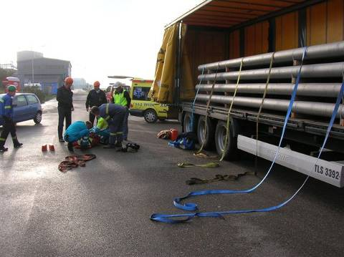
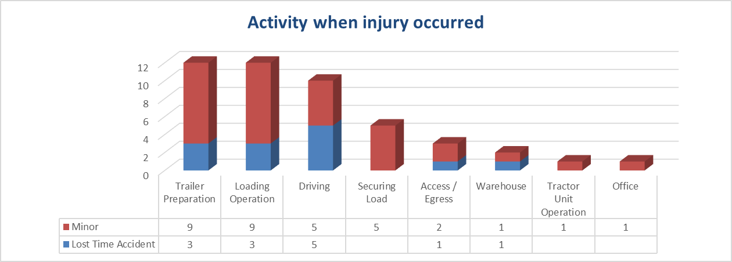
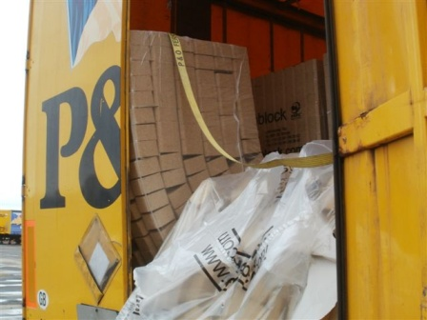
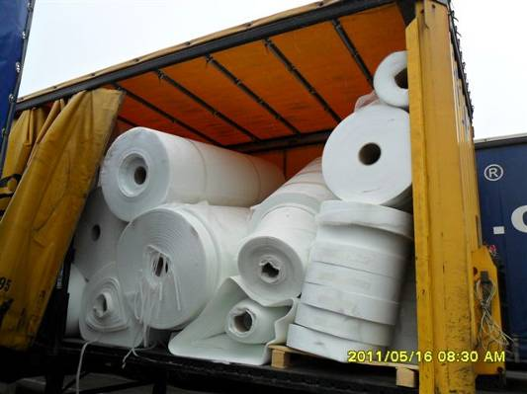

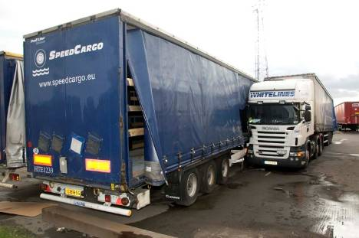

Why are we here?
28th August 2010 –
Fatal Accident, Scunthorpe
Gert Hofstetter, 37 years old,
fell from trailer.
Handicapped for the rest of his life
Based on P&O Ferrymasters accident statistics
Notes:
Between 50-70 injury accidents a year for the last 3 years to both our own employees and to our subcontract partners.
Vary between cuts and bruises to accidents where we and the personnel working on behalf of us, have not been so lucky.
28th August 2010. Barry Shaw. Driver couples to his trailer. Does not apply his handbrake. The tractor and trailer roll. The driver chases and tries to get into the tractor unit. He is crushed to death between his tractor unit and another parked trailer
Gert Hoffstetter, falls from trailer, handicapped for the rest of his life
But aside from incidents resulting in injuries we have a lot of nearlys or near misses. Those that could have caused injury. 2 examples of load restraint are evident in the picture.
So it’s time to change . . . We have procedures in place . . .but its time to put the structure in place to allow us to actively and proactively improve our safety culture, our safety behaviour and the safety of those who work with us and for us.

Slide 4

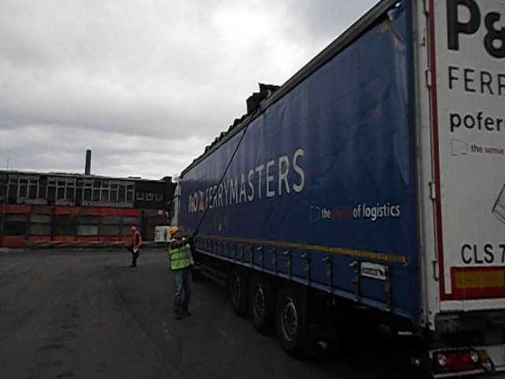
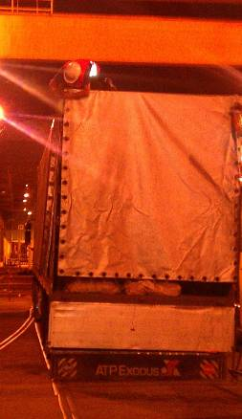
Things have changed....
2019
2000
Notes:
We do have to recognise that the industry has changed and is changing. But also recognise that the industry is at varying levels of maturity and has a multitude of standards and a multitude of levels of enforcement.
The driver on your left was the hero of the day. Solving the problem to enable the job to be done and done quickly. But today, today he is the villain, exposing himself to the risk of falling and serious injury. There are better, safer and quicker ways of doing things and this is the kind of knowledge we need to deliver and share within our industry. Remember safer can often mean quicker and less hassle

Slide 5
Objectives of today’s session
To achieve an understanding of:-
  Personal, equipment, safety and behavioural standards
  Minimum standards for operating a tractor unit and trailer safely
To have sufficient knowledge and understanding to be able to deliver the training package to your drivers.
What do you want to gain from today’s training?
Notes:
So that’s the background . . So from today we want you to achieve an understanding of
Personal, equipment, safety and behavioural standards
Minimum standards for operating a tractor unit and trailer safely
Load restraint theory and methods
But above all, we want you to think about how you can do things in a way that doesn’t put you or others around you at risk of injury
(click)
But that’s enough of me, what do you want to gain from today’s training

Slide 6
Safety Champion – their role
You and your company . . . is responsible for:-
Appointing a Safety Champion
Ensuring that drivers and vehicles understand and comply with the Personal, Equipment, Customer and Operational standards
Notes:
You and your company . . . is responsible for:-
Appointing a Safety Champion
Ensuring that drivers and vehicles conform to the Personal, Equipment, and Safety behaviour standards of P&O
Training drivers
Briefing drivers on Safety Information and Alerts
Reporting Near misses and unsafe behaviours
Investigating and responding to drivers / equipment non-conformances
Reporting all accidents to P&O
Investigating all accidents
Improvement of safety awareness and behaviour

Slide 7
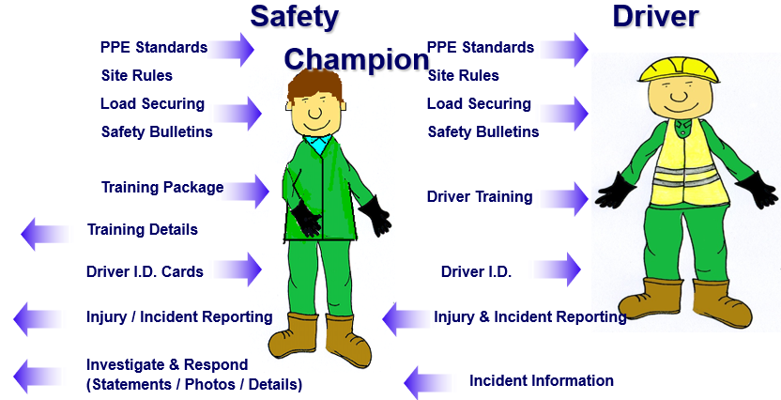

Safety Champion – their role

Slide 8
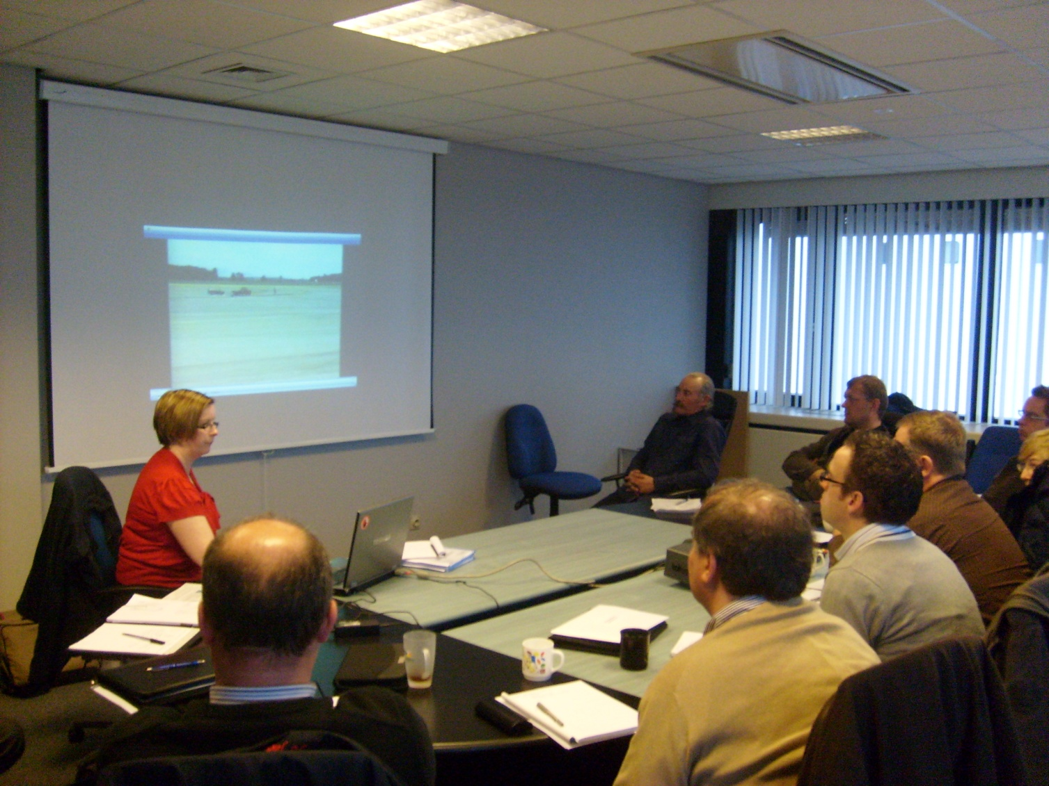
Driver Training Process
Notes:
Process:
Deliver the training

Slide 9
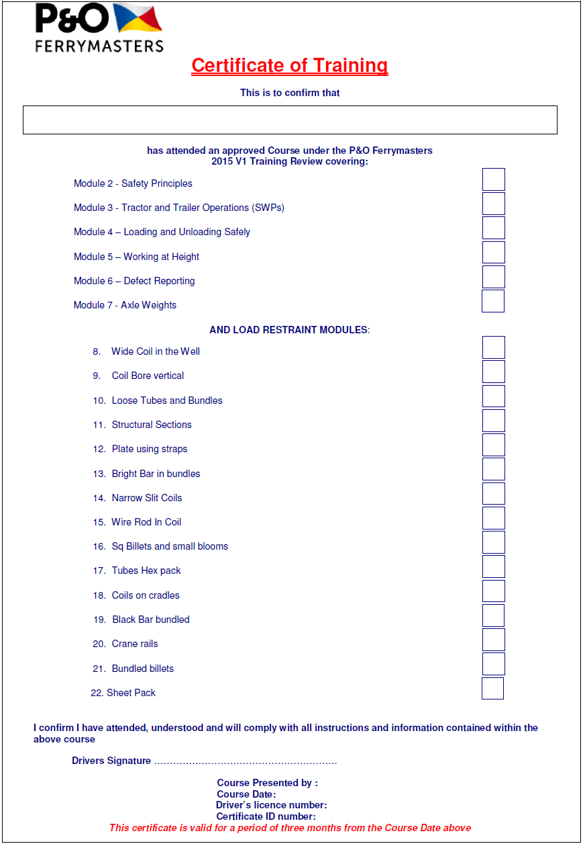
Driver Training Process
Notes:
Complete Certificates (valid for 3 months)
Signed by the driver
Dated

Slide 10
Driver Training Process
Notes:
Record trained drivers in Register / Training Log
Email the register and photo of the driver (digital photograph, titled with the drivers name) to drivertraining@pofm.com

Slide 11
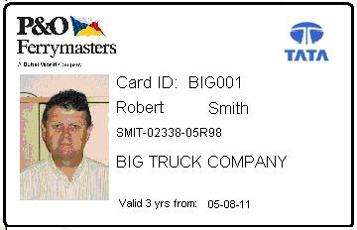
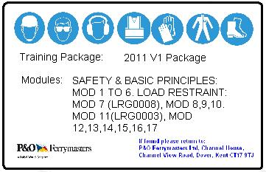
Driver Training Process
Notes:
P&O will process the Driver ID cards and then return them.
Issue Driver ID Card to the driver

Slide 12
Fair Processing Notice
At P&O Ferrymasters Ltd we’re committed to protecting and respecting your privacy.
This policy explains when and why we collect personal information, how we use it, the conditions under which we may disclose it to others and how we keep it secure.
By attending this training, you’re agreeing to be bound by this policy. Any questions regarding this policy and our privacy practices should be sent by email to drivertraining@pofm.com or in writing to POFM Driver Training, P&O Ferrymasters Ltd, Channel House, Channel View Road, Dover CT17 9TJ. Alternatively, you can telephone 01304 224213
How do we collect information from you?
We might collect data from you when you contact us, either on the telephone or via email or in person as part of the identification or registration for training process.
We may collect data from you as part of an on site induction using a software package named Iformbuilder, which is part of Zerion Software. For more information please visit:
https://webstaging.zerionsoftware.com/

Slide 13
Fair Processing Notice
What type of information is collected from you?
      Name
      Contact details
How is your information used?
  We will use your information to:
    keep a record of drivers who have been trained in specific site, safety and load securing guidelines in order to service P&O Ferrymasters Ltd customers.
    complete an attendance certificate;
    create a driver training card;
    notify you of changes to our services;
    send you communications which you have requested and that may
    be of interest to you;

Slide 14
Fair Processing Notice
We review our retention periods for personal information on a regular basis. We will hold some types of information, for example data about your training, to fulfil our obligations for up to seven years,
Depending on the type of data we will hold your personal information on our systems for:
We will retain your name, address, photograph, employer and driving licence data for seven years
We will retain your payment details (where given) for seven years
Who has access to your information?
Your information may be collected by P&O Ferrymasters staff using a software package from Iformbuilder, which is part of Zerion Software. Zerion Software is a US based company and adheres to the Privacy Shield Principles (https://www.privacyshield.gov/) and the EU GDPR regulations. For further information please visit: https://webstaging.zerionsoftware.com/security/gdpr/

Slide 15
Fair Processing Notice
The information collected will be uploaded to our internal database for the recording of driver training and processed locally for Driver Training Card manufacture. All details are held on a central secure server in the UK, only staff who have specific security permission can access the data.
We will share your information with Euclid (https://www.euclid.co.uk/) using their secure web portal, for the manufacture of driver training cards on behalf of P&O Ferrymasters Ltd, for all drivers trained by P&O Ferrymasters Ltd. For more information please visit: https://www.euclid.co.uk/privacy-policy
How you can access and update your information?
The accuracy of your information is important to us. If you would like to access to the data we hold on you please contact: drivertraining@pofm.com Alternatively, you can telephone 01304 224213

Slide 16
Fair Processing Notice
How you can access and update your information – cont.
You have the right to ask for a copy of the information P&O Ferrymasters Ltd hold about you
You have the right to request that the data we hold on you is erased or rectified. For example, if you don’t want us to use your information for views and comments on the services we provide, you can ask to have your contact details removed.
How do I complain to the regulator?
If you would like to complain about the way we handle data please visit the Information Commissioners Office: https://ico.org.uk/concerns/

