Slide 1
Safety Principles
P&O Ferrymasters
Driver Training Programme 2019 v1

Slide 2
Safety Principles
Safety Principles
  Standards, Education and Behaviour
    Personal
    Equipment
    Loose Equipment
    Tractor Units
    Trailers
    Reversing
    Customer standards
Notes:
This module covers a variety of areas. It explains 3 things to consider in terms of what goes wrong with Safety, before explaining some of the basics, which I hope will come as no surprise to anyone . . .when we look at standards. We then have some more interactive sessions when we look at Risk, working at height and manual handling.

Slide 3


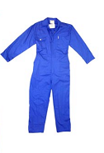
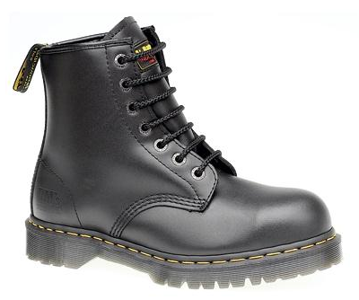

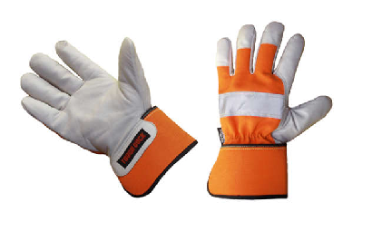
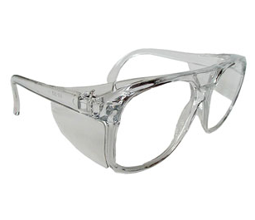
PPE Standard

Slide 4
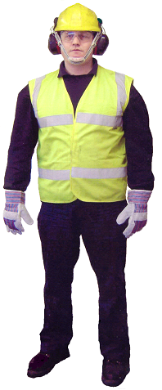







Personal Standards
Personal Protective Equipment
The Seven items of PPE that every driver
should have
Notes:
So what are some of the standards we have . . .well from a general overview we are going to go through many of the basic or core standards now. After lunch we will cover the operational standards when working in and around trailers and tractor units.
Lets start with the basics . . .your personal equipment . . .
Despite popular opinion, Personal Protection Equipment isn’t there to make you look glamorous, and it’s not there to make you look silly . . .it’s there for your personal protection. The requirement to wear PPE in certain areas, for example warehouses is based on someone assessing the risk in that area and how it can best be managed or controlled to prevent harm (a topic we will cover later). So often PPE is a standard in warehouses to manage risks imposed by sites and locations, but what is it also . . .it is equipment that you can wear to protect yourself. How many of you wear a hi-visibility vest when you are working or walking around yours or other vehicles?
There will be standards that when communicated will require you to wear PPE when you are performing different tasks, these should be known and communicated, but then it is your responsibility for your own personal safety to comply with these..
The exact PPE to be worn will be indicated at the time of arrival by either an Induction or demonstrated by appropriate Blue and White Safety Signage.
If you have all of the above items, then you can be confidently loaded at most sites..

Slide 5

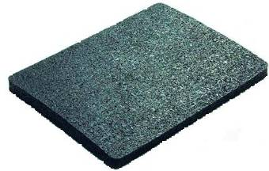
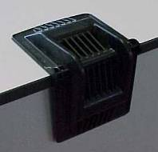
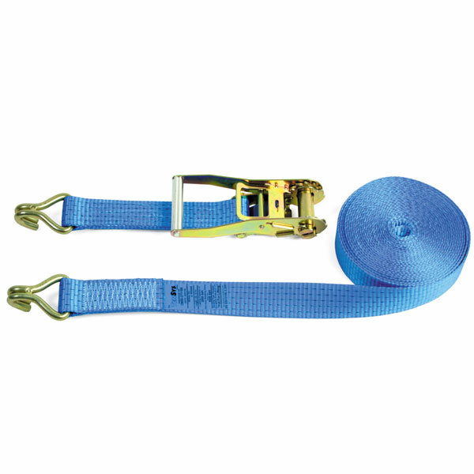
Equipment Standard

Slide 6
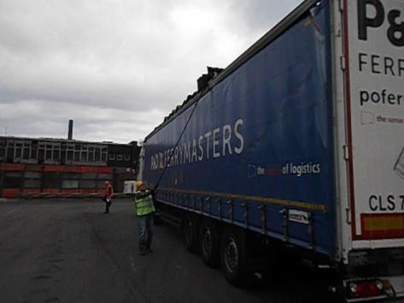
Equipment Standards
Roof Pole
Notes:
The roof pole is a basic piece of equipment for any driver with a sliding roof trailer. At some point you are going to have to open your roof, and you can’t do it safely without one. Has everyone here got a roof pole?

Slide 7
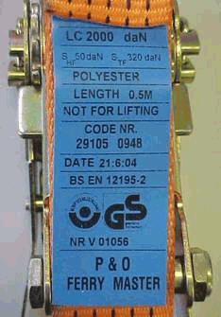
Webbing Straps . . .
Lashing Capacity = Amount of force a restraint can take, in a straight pull without damage.
2000 daN = 2,000 deca Newtons
= 2,000 x 10 Newtons
~ 2,000 kg force
~ 2 tonnes force
Lashing Capacity
2000 daN
LASHING CAPACITY
DOES NOT MEAN
The weight of the load that a strap will restrain.
eg 24 ton load does not mean 12 LC2000 straps.
Must comply to EN 12195-2
Notes:
ONLY STRAPS WITH LABELS SHOWING THE LC CAPACITY AND STANDARD – EN 12195-2 ARE ACCEPTABLE.
STRAPS WITHOUT LABELS ARE NOT ALLOWED.
WITHOUT A LABEL THE LASHING CAPACITY CANNOT BE PROVED
2 TON FORCE NOT WEIGHT!

Slide 8
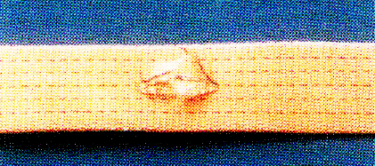
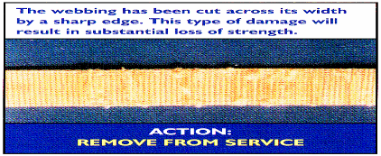
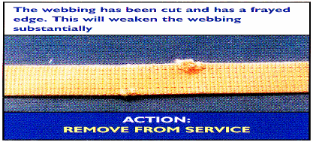
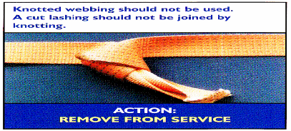
Webbing Straps . . .
Damaged core => renew
Cut across width => renew
Frayed edge >10% => renew
Never use with knots – halves the strength
See Technical Information Sheet TIS-0003
Webbing straps and ratchets
Notes:
Typical damage to webbing straps.
Top right is most common. Suitable edge protection has not been used. Multiple minor grazes the full width of the strap, indicates the strap was rubbing on a sharp edge.
DAMAGED STRAPS WILL NO LONGER RESTRAIN TO THE LASHING CAPACITY THEY HAD A TIME OF MANUFACTURE.

Slide 9
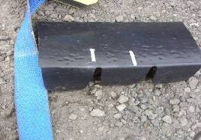
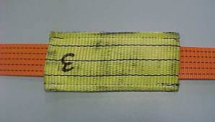
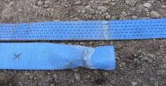
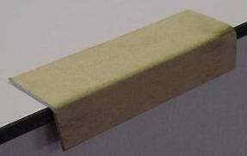
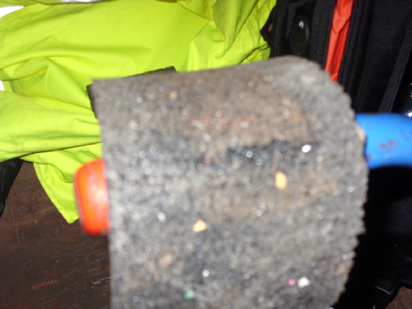
Strap Protection
P
P
Bespoke packaging
Note: use only in specified location or straps may slip off
Heavy Duty Webbing sleeves
Special mouldings
O
Thin webbing sleeves
Twist and cut easily
O
Anti-Slip matting
Cuts very easily
!
General purpose
CAUTION: straps may slip off
See Technical Information Sheet TIS-0005
Edge protection
http://www.poferrymasters.com/tatasteel/health-and-safety/load-restraint-guidelines/
Notes:
Approximate relative costs for new high friction rubber are:
1m strip of 10mm thick, 100mm wide costs about 75p. It can be re-used but will wear out and may get contaminated with oil or dust.
Comes in various thicknesses, but for steel loads it needs to be at lease 8mm thick. 10mm preferable.
Too thick and it can shear (don’t go above 15mm)
Don’t think conveyor belt rubber will do the same job – it won’t, it is designed to be hard wearing and is slippery especially when wet.

Slide 10
Anti-slip matting
Specialised Anti-Slip Matting
  Coefficient = at least 0.60 wet or dry
  3-20 mm thick; about 8-10 mm optimal
  NOT a universal solution - can wear rapidly - inspect before use
  NEVER USE AS EDGE PROTECTION!! It cuts easily
Conveyor belting
  Harder = Slippery
  Wet - sometimes very slippery
  Typical friction about 0.40
See Technical Information Sheet TIS-0008
Anti-slip matting
Notes:
Approximate relative costs for new high friction rubber are:
1m strip of 10mm thick, 100mm wide costs about 75p. It can be re-used but will wear out and may get contaminated with oil or dust.
Comes in various thicknesses, but for steel loads it needs to be at lease 8mm thick. 10mm preferable.
Too thick and it can shear (don’t go above 15mm)
Don’t think conveyor belt rubber will do the same job – it won’t, it is designed to be hard wearing and is slippery especially when wet.

Slide 11
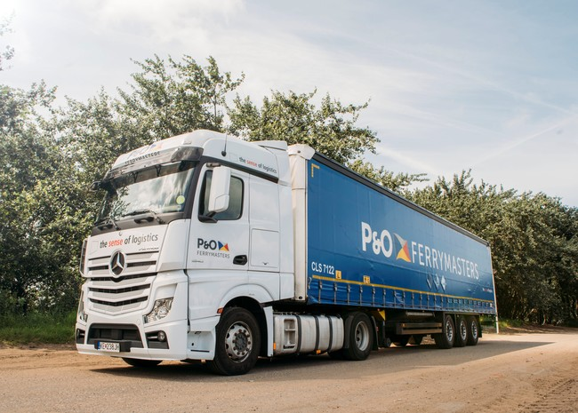
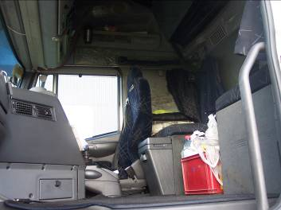
Tractor Unit Standards

Slide 12
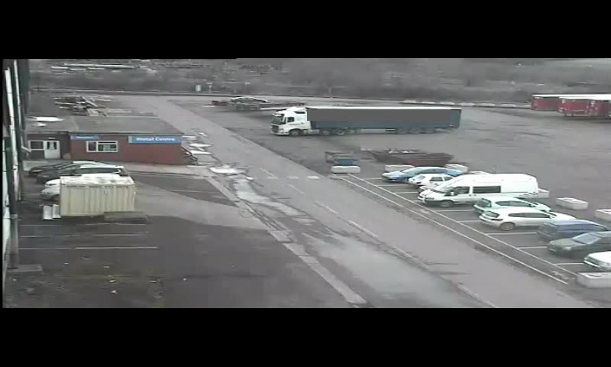
Rotherham Roll Away

Slide 13
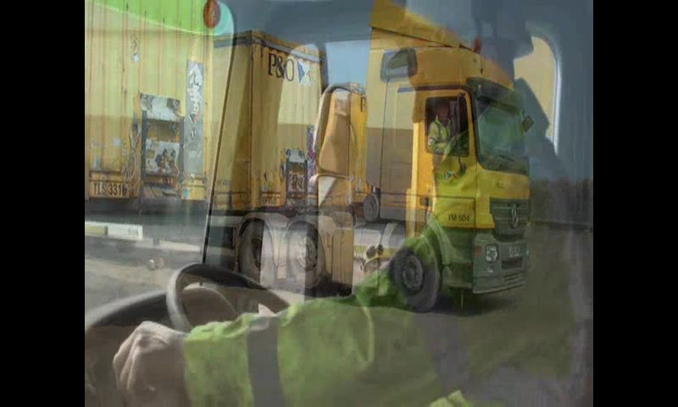
Applying Truck hand brake

Slide 14
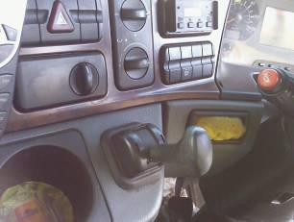

Tractor Unit Standards

Slide 15
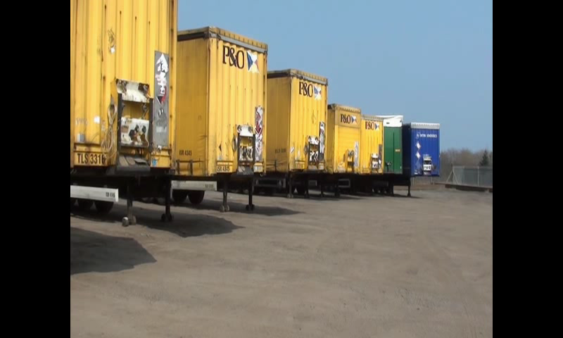
Reversing Alarm video

Slide 16
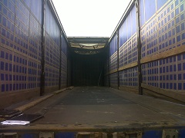
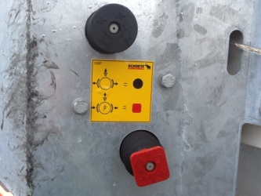
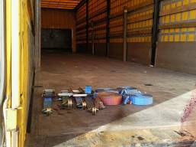
Trailer Standards

Slide 17
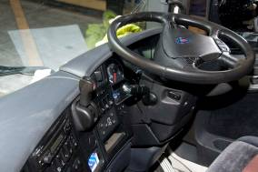
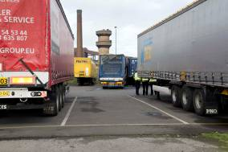
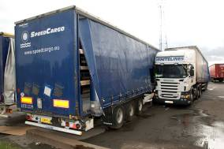
Trailer Standards
Saturday 28th August 2010, Scunthorpe, UK
What happened:
  Driver came to collect a loaded trailer
  He dropped his empty trailer and then reversed under the loaded trailer
  Engine was running. Handbrake was NOT applied
  Tractor and trailer rolled away
  Driver tried to get back into the tractor unit to stop it.
  Driver was crushed to death
Learnings
  Standard:
    Handbrake must be applied
    Engine off
    Keys out

Slide 18
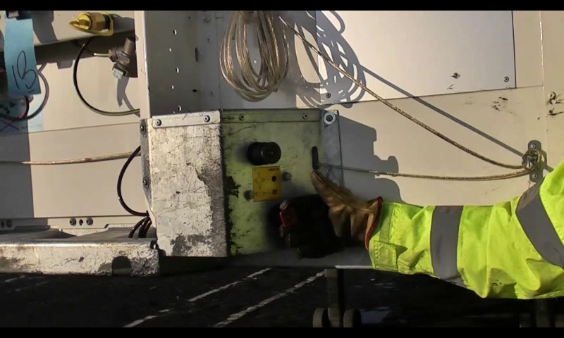
Applying trailer park brake video

Slide 19
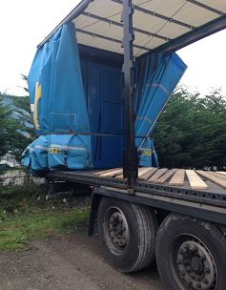
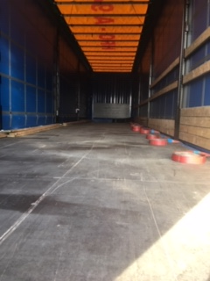
Trailer Standards

Slide 20
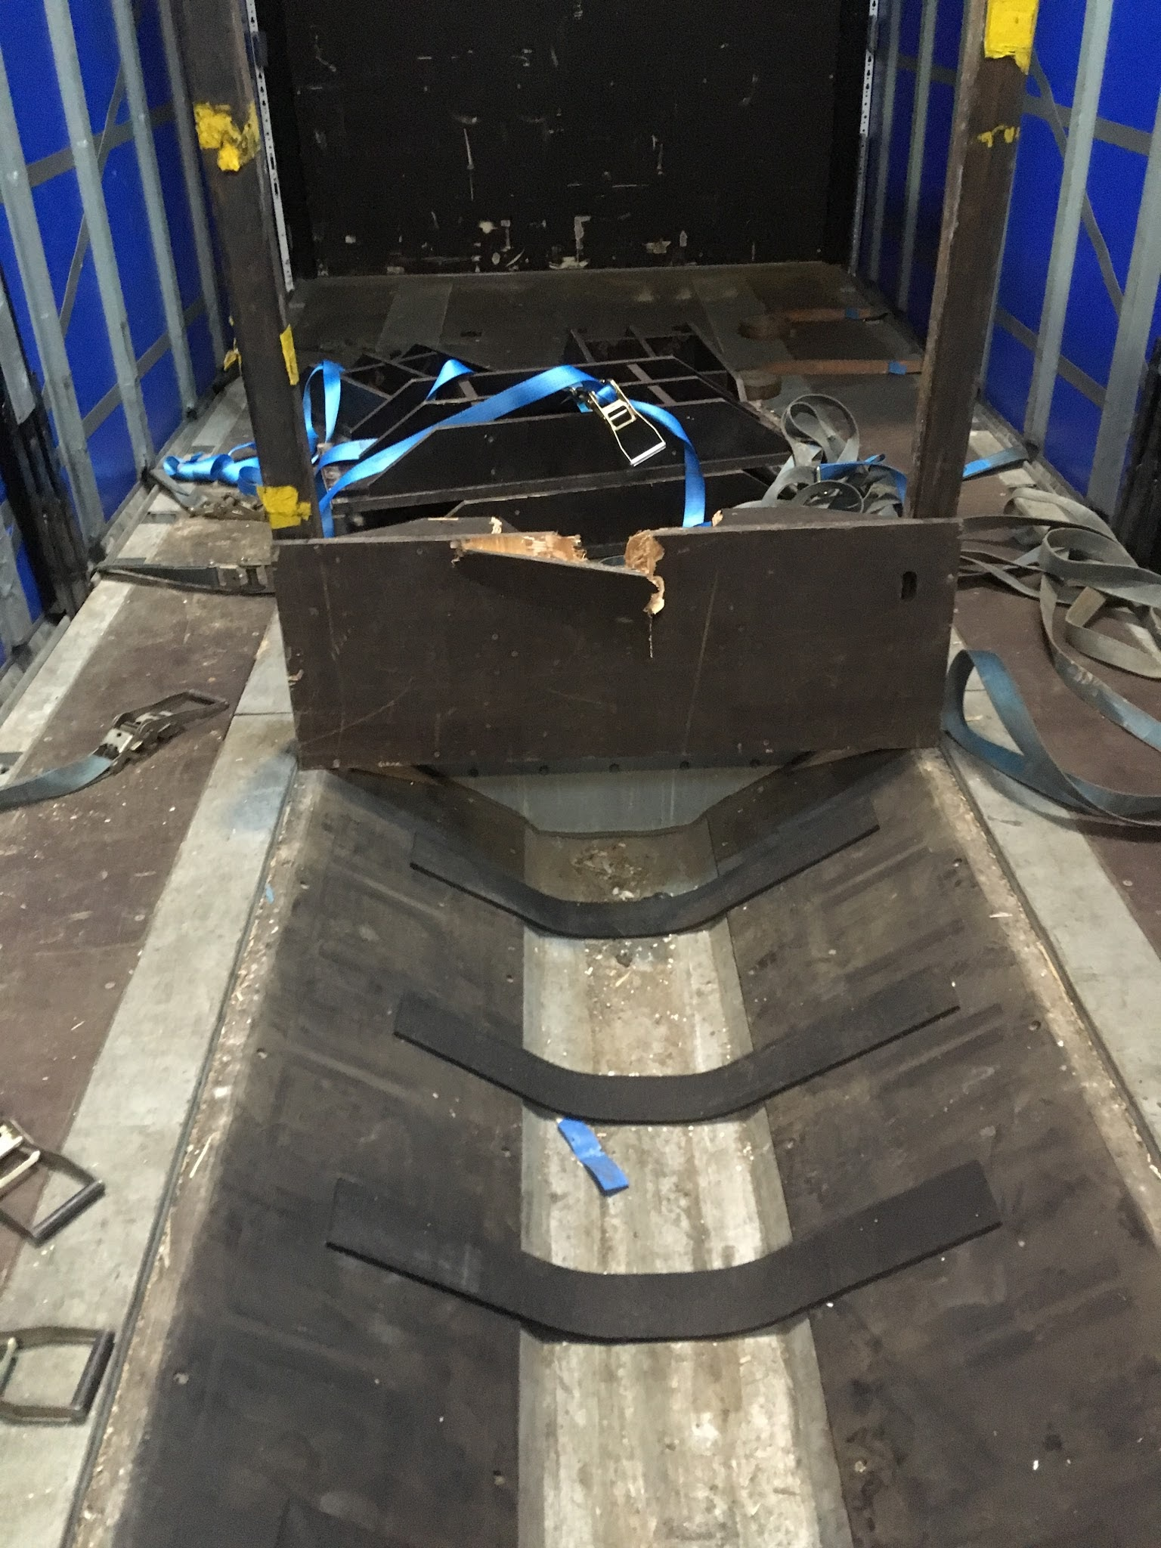
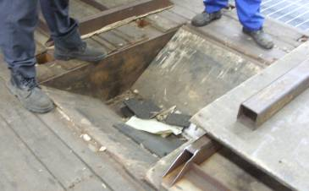
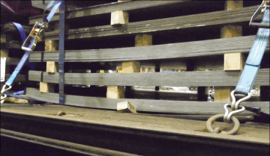
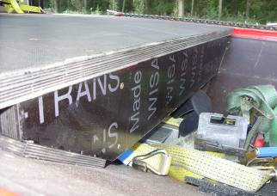
Trailers – well boards and decks
Condition / design strength
Keep base of well clear
O
O
O
See Technical Information Sheet TIS-0006
Well boards for well trailers

Slide 21
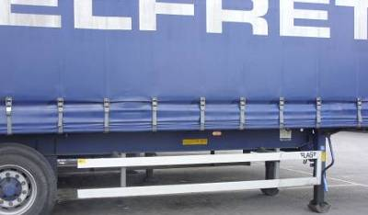
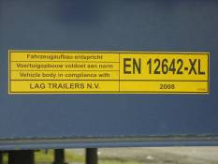
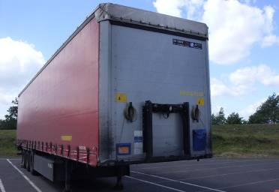
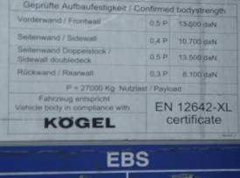

Trailer Headboards
P
EN 12642-XL
‘13 tonne’ headboard = 0.5g
‘10 tonne’ sidewall = 0.4g
‘8 tonne’ rear doors = 0.3g
EN 12642-L
‘5 tonne’ headboard = 0.2g
‘3 tonne’ rear doors = 0.1g
!
See Technical Information Sheet TIS-0010
Trailer Headboards
Notes:
Plaques will be located on chassis frame and/or the front of the headboard.

Slide 22
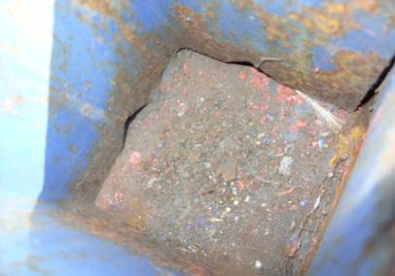
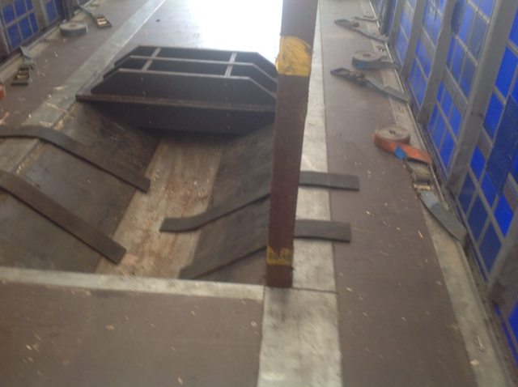
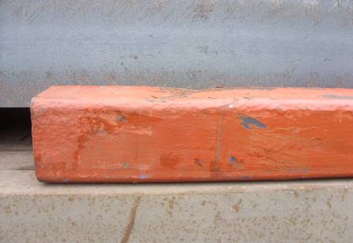
Trailers – posts and sockets
Varying sizes
  Minimum 80 x 80 x 5mm thick
Condition / corrosion
  Can seriously weaken posts
  Should be inspected / maintained
Notes:
Well post and well sockets can easily corrode from the inside. The post in the test above had corroded from its design of 6mm thick down to 3.8mm and started to fail as the coil toppled against it. Testing had to be abandoned because of the corroded posts.

Slide 23
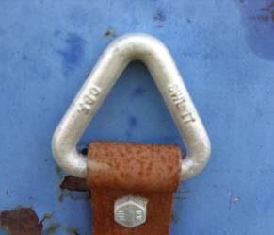
Trailers – anchor points
Standards exist but not often identified on trailers
Lashing capacities vary from 1 tonne, 2 tonne (common) or higher
Angle of lashing - may be designed for a limited range e.g. 120º cone
Number / spacing – may vary from every 425mm to every 2m!
Don’t over-load by putting 2 or more lashings to one point
- unless they work in different directions
See Technical Information Sheet TIS-0009
Lashing points
Notes:
Anchor points vary considerably.
The triangular one is a 1 tonne capacity which is only any good for pre-tension of straps. Trying to put a chain in it would over-stress it.
Putting two 2 tonne straps onto one anchor point will overload it if they are both pulling in the same direction, but if one is acting as forward restraint and the other is acting as rearward restraint, they won’t act at the same time.

Slide 24
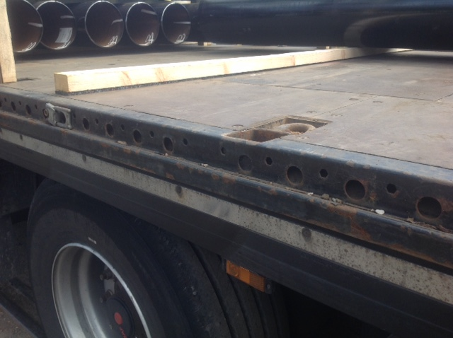
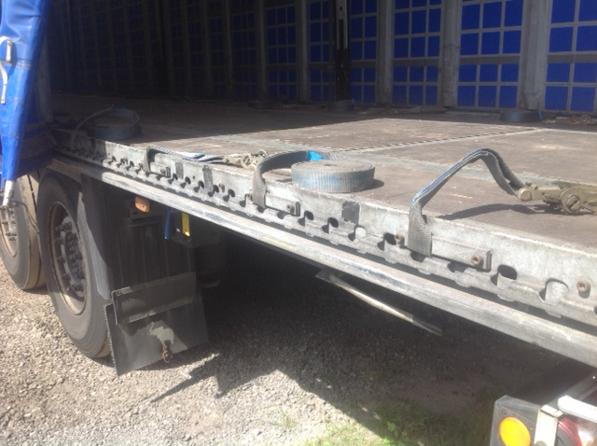
Trailers – anchor points
Don’t over-load by putting 2 or more lashings to one point
- unless they work in different directions
See Technical Information Sheet TIS-0009
Lashing points
Notes:
Anchor points vary considerably.
The triangular one is a 1 tonne capacity which is only any good for pre-tension of straps. Trying to put a chain in it would over-stress it.
Putting two 2 tonne straps onto one anchor point will overload it if they are both pulling in the same direction, but if one is acting as forward restraint and the other is acting as rearward restraint, they won’t act at the same time.

Slide 25






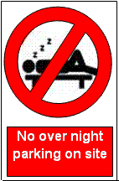
Customer Standards
Respect speed limits
Rail has priority
NO PASSENGERS
NO CHILDREN
No alcohol or drugs
Put all rubbish in bins provided
Notes:
In addition to standards that you should be trained in and that you should adopt yourself, there are customer standards which are there to again keep you safe and keep those who work with you on the sites safe as well.
You must obey the sites Safety Rules
The site is responsible for YOUR safety – You must therefore comply with their instructions.
Click
No passengers are allowed on customer sites and within vehicles
Click
BEING UNDER THE INFLUENCE OF ALCOHOL OR DRUGS IS NOT PERMITTED – GIVEN DUE CAUSE A DRIVER WILL BE ASKED TO PROVIDE A BREATH TEST SAMPLE – SHOULD THE TEST BE POSITIVE THE DRIVER WILL NOT BE ALLOWED TO CONTINUE TO WORK ON SITE AND THE POLICE WILL BE ADVISED ACCORDINGLY
Click
RAIL ALWAYS HAS PRIORITY – NEVER ATTEMPT TO BEAT THE RED LIGHT
Do not use mobile phones when driving
Click
Report any accidents or incidents

Slide 26
Quiz
What standard of straps is required?
What must you carry and use to open and close a sliding roof?
What are the basic items of PPE that should be carried?
What are the 3 key things to remember before you exit your tractor unit?
Have a Label
Comply with EN12195 –2
Minimum lashing capacity of LC2000daN
Be in good condition.

Slide 27
Quiz
Why is anti-slip matting good for load restraint?
    It provides 0.6g of friction which is very high
    Steel on rubber provides higher friction than steel on timbers
Why and when should you use edge protection?
    To prevent straps from being cut or damaged
    Always use wherever straps are in contact with a sharp edge
What should you look out for in used straps?
    Damaged, cuts, frayed edges or knots
Notes:
Name the key European Guidance documents for load restraint?
UK – DFT code of practice
EU EN12195-2
DE VDI2700
What are the forces to secure to in EN12195-2?
0.8g forwards
0.5g sideways
0.5g backwards
Why is friction important?
It is a vital part of the load restraint system, helping to prevent steel from moving
What are the 4 types of load restraint methods?
Tie down
Blocking
Direct Restraint
Containing
Name 2 things that could cause load restraint to fail.
Timber dunnage, double stacked
Toppling
Sliding
Gaps in loads
Rotating
Vehicle stability
What should you do if a load has vertical gaps?
Ask the Loading team to re-configure the load
If safe to do, plug gaps with timbers
What is the strap standard?
LC2000daN minimum
What should you look out for in used straps?
Damaged, cuts, frayed edges or knots
Why and when should you use edge protection?
To prevent straps from being cut or damaged
Always use wherever straps are in contact with a sharp edge
Why is anti-slip matting good for load restraint?
It provides 0.5g of friction which is very high
Steel on rubber provides higher friction than steel on timbers

