Slide 1
Working at Height
P&O Ferrymasters
Driver Training Programme 2019 v1

Slide 2
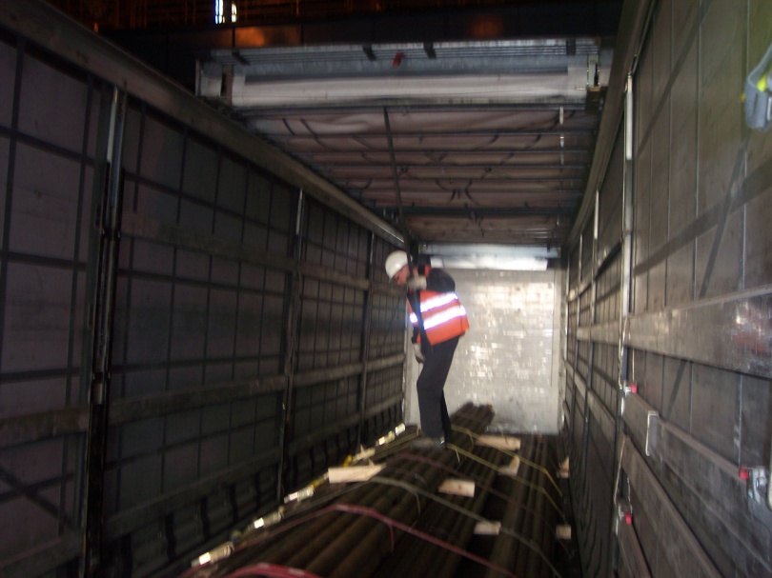
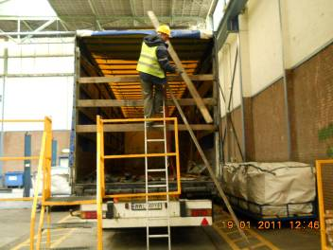
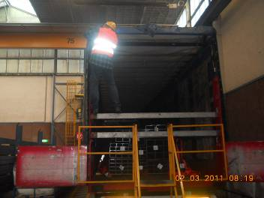
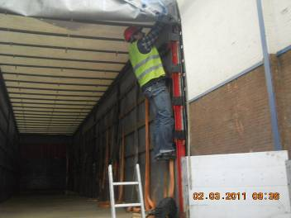
Guiding Principles – Working at height
✗
✗
✗
✗
Notes:
So what kind of examples of working at height do we see?
Working on the load – risk of falling, slipping, trapping leg in the load
Balancing
Climbing
Who has ever done any of these? And Why?
So what precautions can you take . . . Remember our precautions from assessing risk . . .
Can we eliminate?
Can we reduce?
Can we control?
Can we protect / wear PPE?

Slide 3
Guiding Principles - Working at height
Plan
Assess the risk
Decide on precautions
Notes:
So what are the steps you can and should take to minimise the risk of falling when working at height. These are going to sound familiar by now.
Firstly . . . Plan – identify what you need to do and why you need to do it
Secondly . . . Assess risk – who can remember the steps in this? Identify the hazards, identify who can be harmed and how
Finally . . . Decide on precautions – what can be done to eliminate, reduce, control the risk and protect you from harm

Slide 4

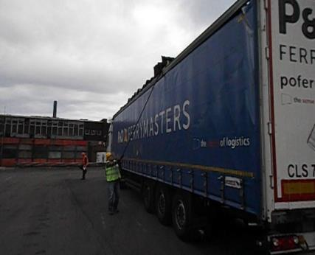
Guiding Principles - Working at height
AVOID WORKING AT HEIGHT - Can the work be done at ground level ?
Avoid Getting Up At All, If You Can!
✗
Notes:
This slide and the following seven slides explain in more detail, the simple precautions we can take to manage the risk of working at height . . So what do we start with . . .can we eliminate the risk?
Firstly avoid working at height if possible. If you can do it from the ground, then . . . Do it from the ground. Why get up on the trailer to open your roof when most trailer roofs (many more than you realise) can be opened from the ground.

Slide 5
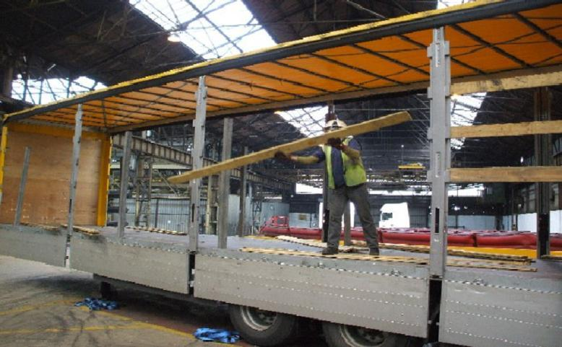
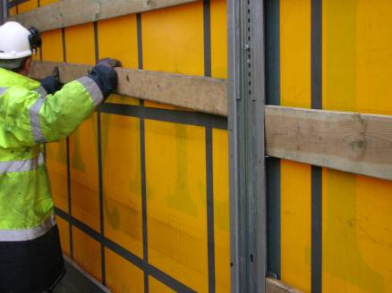
Guiding Principles - Working at height
✗
✓
Do not work next to an ‘Open edge’ –
make sure you are enclosed
Notes:
Eliminate the risk of falling from the side of a trailer by making sure that you are not working on an open edge. Keeping your curtains closed when replacing timbers, securing loads, opening and closing roofs, offers a level of protection which will prevent you from falling . . .simple solutions

Slide 6
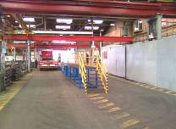
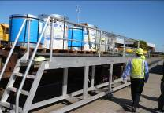
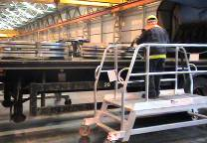
Guiding Principles - Working at height
Use Platforms, steps and fall Protection systems…..
Full Height Fixed Platform
Full Height Platform
Half Height Platform
Notes:
Crossing from the eliminating to reducing precautions . . .make use of available platforms and steps which will allow you safe access and the ability to work more safely at height, however you obviously are still working at height. They are there for your use.

Slide 7
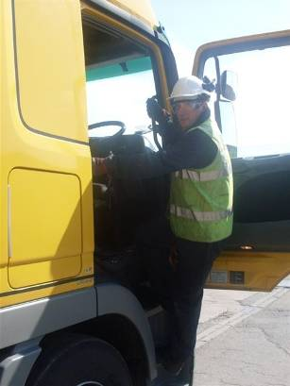
Guiding Principles - Working at height
1
2
3 points of contact
3
Notes:
So now we come onto controlling working at height. . . .Make sure you maintain holds and contacts with hands and feet. This might be getting in and out of your tractor unit, accessing the 5th wheel area or . . . (next slide)

Slide 8
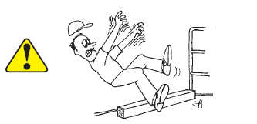
Guiding Principles - Working at height
Never Step backwards!!
Notes:
Some further considerations for controlling the risk of falling when working at height . . .never step backwards. Sounds obvious, but it’s something we do everyday, take a step back to get more perspective on something . . . Or give something a bit of thought . . .that’s great to do . . .but when you don’t have the space to take that step back. Also you need to be careful about what can be behind you. Make sure you have a clean and hazard free trailer bed or surface to work on

Slide 9
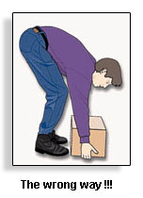
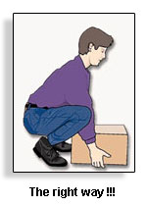

Guiding Principles - Working at height
✗
✓
Notes:
Control your movements . . . Be aware that many fall injuries are sustained when people have their head below their shoulders.
If you keep your head above your shoulders and squat rather than bend, then you are lowering your body position but also preventing a rush of blood to the head which can cause an overbalance and you to topple or stumble

Slide 10
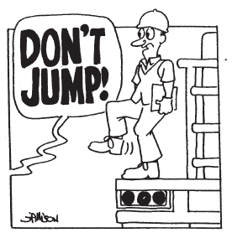
Guiding Principles - Working at height
Never Jump!!!
Notes:
Control – don’t jump . . .by jumping you are not using 3 points of contact, you are increasing the force on your body and the height and distance you travel. Jumping from trailers has resulted in a sprained ankle and many weeks off work. Turn around, use steps and climb down using 3 points of contact is the way to do it.

Slide 11
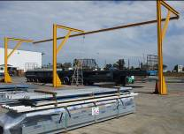
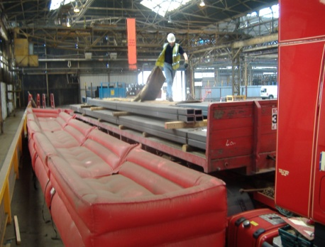
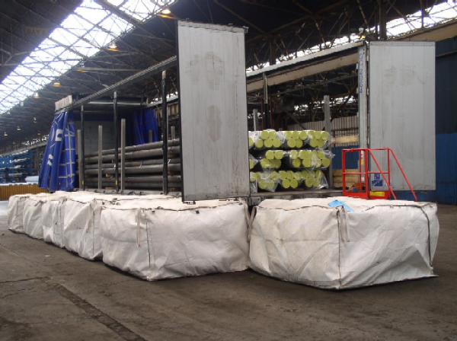
Guiding Principles - Working at height
Use Platforms, steps and fall Protection systems…..
Fall Arrest System
“Soft Landing” Bags
Soft Landing Air Bags
Notes:
Fall protection systems that control / protect you from injury if / when you fall are an example of protection. They do not eliminate or control. It is recognised that these systems are not about preventing you from falling but are saying that when you do fall they will reduce the level of injury. Having said that, you need to use them as they are designed. Do not leave gaps between the bags and the trailer, people have fallen in between the fall protection and the trailer. Make sure you follow the guidance given at the point of loading

Slide 12

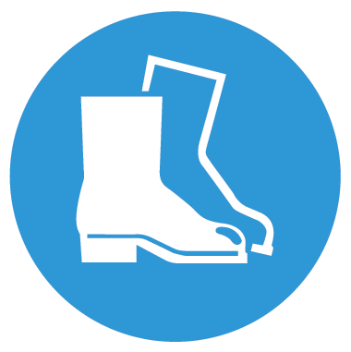

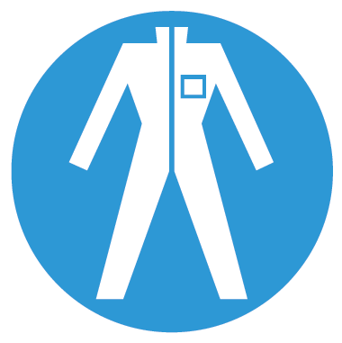



Guiding Principles - Working at height
Hard Hats with Chin Straps have prevented many serious injuries in falls from trailers
Notes:
And finally the last option . . .personal protection equipment. If you fall you are going to be injured, but wearing PPE can reduce the level or seriousness of these injuries. Wearing a helmet with a chin strap can prevent the helmet from falling off when you fall, and thus has prevented head injury in the past. Wearing sturdy boots can offer greater ankle support, preventing twisting. Gloves and covered arms and legs may prevent cuts and grazes when you fall to the ground. However . . .if you follow the advice in the previous slides then you will not get to this stage.

Slide 13
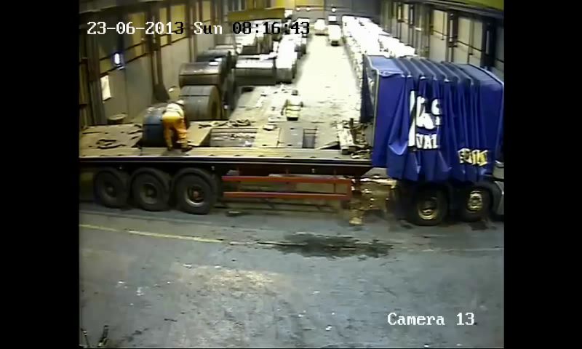
Guiding Principles - Working at height
Notes:
So in summary
Plan, Assess the risk, decide on the precautions . . .thinking about the different levels of controls

Slide 14
Guiding Principles - Working at height
Plan
Assess the risk
Decide on precautions
  Eliminate
    Avoid working at height (work from the ground)
    Don’t work on open edges
  Reduce
    Use steps, platforms, fall prevention and protection systems
  Control
    Use 3 points of contact
    Never step backwards
    Keep your head above your shoulders
    Never jump
  Protect
    Wear Personal Protection Equipment
Notes:
So in summary
Plan, Assess the risk, decide on the precautions . . .thinking about the different levels of controls

Slide 15
Quiz
What items of PPE are considered most important when working at height?
What precautions should you take when working at height?
Eliminate
  Avoid working at height (work from the ground)
  Don’t work on open edges
Reduce
  Use steps, platforms, fall prevention and protection systems
Control
  Use 3 points of contact
  Never step backwards
  Keep your head above your shoulders
  Never jump
Protect
  Wear Personal Protection Equipment
Hard Hat with Chin strap

