Slide 1
Defect Reporting
P&O Ferrymasters
Driver Training Programme 2019 v1

Slide 2
Agenda
Communication and Reporting
  Daily Checks and Defect Reporting
Notes:
This module looks at a variety of topics including checks and defect reporting, what to do in an incident, documentation and your role, that of a driver

Slide 3

Daily checks and Defect Reporting
Regular maintenance is essential
All hauliers should have their own Defect Reporting Procedure
If a driver encounters a problem with his trailer, they should know who to contact to report the fault
The fault should be logged and repaired as soon as possible
Notes:
Maintenance is essential, but the responsibility of your managers and companies, however the checking of equipment and reporting of defects is your responsibility. Every company should have it’s own defect reporting system, in order to capture and resolve problems with the tractor unit or trailer

Slide 4
Discussion
Do you know how to report defects?
Notes:
Do you know how to report defects in your companies? Do things get fixed?
What should you check daily? (click to next slide)

Slide 5
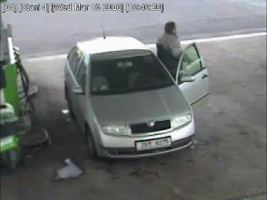
And if checks are not made . . .
Notes:
And if you don’t make checks and report and rectify defects the outcome can be catostrophic

Slide 6

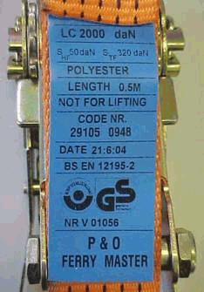

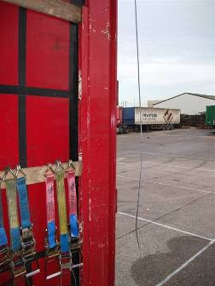
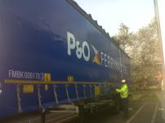
Pre-arrival checks – what do I need to load?
Do I have all the equipment I need?
  Personal Protection Equipment
  Roof Pole
  Load securing equipment (straps; edge protection; timbers)
Is my equipment in a good condition?
  Does my roof open and close easily?
  Are my curtains free from holes?
  Is my trailer bed dry, clean and tidy?
Answer: No . . .
Please do not arrive at site
Notes:
So we’ve covered the checks that you should make every morning. What checks should you make prior to arriving at a loading site?
Firstly, it comes back to the safety principles . . . Do I have the equipment I need . . .Do I have all the PPE I require? Do I have my roof pole and do I have the load securing equipment I need for the load that I am collecting – enough straps of the correct standard, sufficient edge protection and any required timbers.
If I have everything then, is my equipment in good condition? Does my roof open and close easily? Are my curtains free from holes and is my trailer bed clean, tidy and dry?
If the answer to any of these questions is no, then you need to rectify the situation before arriving for loading. Either purchase the correct PPE or a roof pole. Replace straps. Defect the roof or curtains.
Then you can arrive and expect a safe, speedy and hassle free loading experience

