Slide 1
Toyota Training (EN)

Slide 2
Objectives
To train you in:-
  Importance of Safety
  High Risk Areas
  Reporting Safety Concerns
  Stop, call, wait
  Site Rules
  Site Information
    Burnaston, UK
    Deeside, UK
    PL
    CZ
Following this training you will be asked to complete a test
On successful completion you will be issued with a Driver Training Card

Slide 3
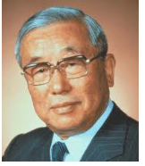
Introduction
Safe work
Reliable work
Skilled work
“Safe work is the door to all work.
Let us pass through this door”.
-Eiji Toyoda, 1957
Safety has been a priority in Toyota since the founding of our company.

Slide 4
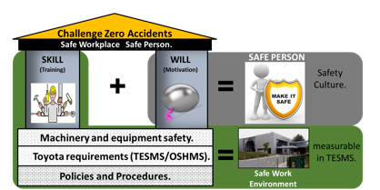
Introduction
I CAN
I WILL
I AM SAFE

Slide 5
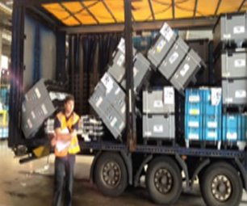
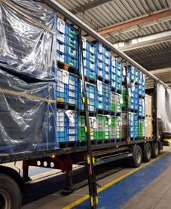
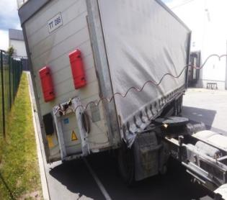
High Risk Areas
Secure loading
Equipment failure
Unhooking accidents

Slide 6
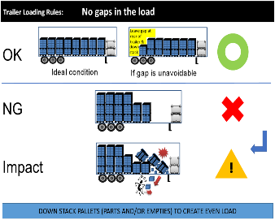
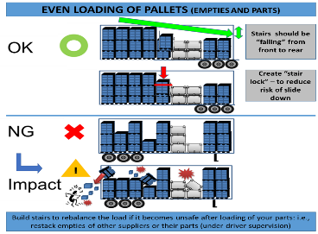
Secure Loading
No gaps between loads
No uneven layers
Straps applied to pallets

Slide 7




Strapping – Pallets and Stillages
=
Use the facilities at the site (steps / platforms) to apply straps (do not climb)
Strap every row of product
You may require 17 straps
Ready for unloading remove ALL straps from the trailer. Do not leave any straps on the trailer

Slide 8
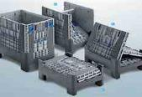
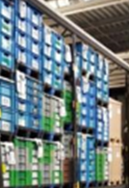
Strapping – Kolox
=
No straps are required

Slide 9
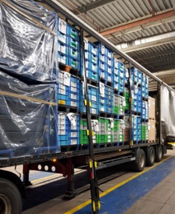
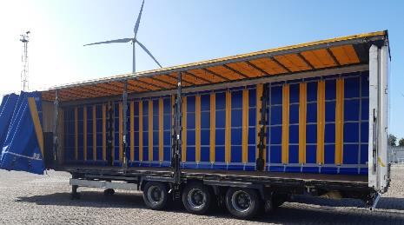

Equipment Failure
Side posts / Roof Supports
Visual check that bolts are present
Check mechanism in the side post is ok
Defect trailer and report defects

Slide 10
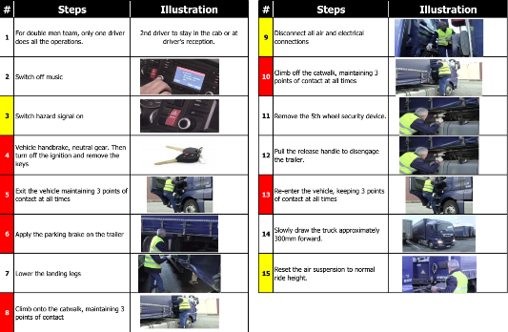
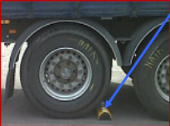
Uncoupling / Unhooking
Follow the procedure from 1-15
You will be checked / audited
  3 x Yellow failures = 1 Red
  1 x Red = 1 Red
  3 x Red in 12 months = Suspended

Slide 11
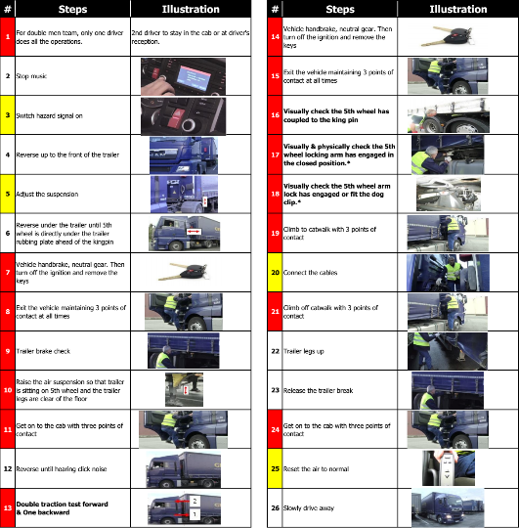
Coupling / Hooking
Follow the procedure from 1-26
You will be checked / audited
  3 x Yellow failures = 1 Red
  1 x Red = 1 Red
  3 x Red in 12 months = Suspended

Slide 12
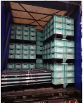
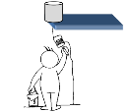
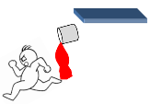
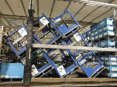
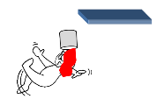
Report Safety Concerns, Near Misses and Accidents
This is a Safety Concern.
  Nothing has happened, but there is the potential that it could.
  Identifying and rectifying safety concerns will reduce near misses.
This is a Near Miss.
  An incident has occurred, but nobody was injured.
  Identifying and rectifying near misses will reduce accidents.
This is an Accident.
  An incident has resulted in a person being injured.
  The person must get medical treatment or advice and record the incident in the Accident Book.

Slide 13



Stop, Call, Wait
If you are concerned about the safety of any task you have to carry out, you should always Stop, Call, Wait
STOP what you are doing immediately if you identify a concern or are unable to carry out your task as normal
CALL your Supervisor or another appropriate person and report your concern
WAIT until you are given clear guidance on how to carry out your task safely before proceeding

Slide 14






Site Rules
Safety Shoes must be worn
Keep to site speed limits
Never use your phone whilst driving or walking
Hi Vis Vests must be worn
Stop at stop signs and lines
Smoking is only allowed in designated areas

Slide 15
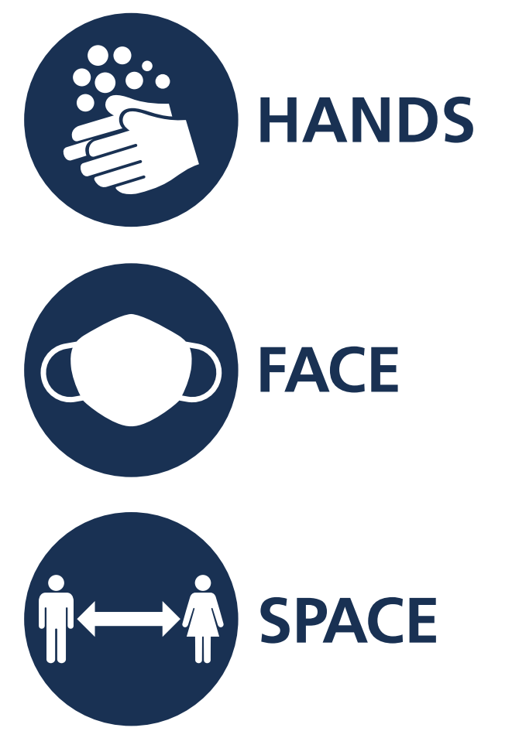
COVID

Slide 16
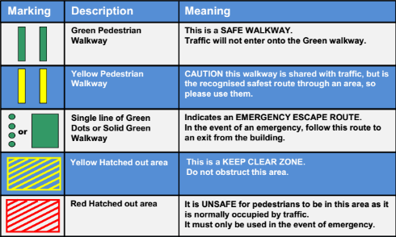


Site Rules – Walking and Walkways
Follow the walkways
Do not walk and use your phone
No hands in the pockets while walking

Slide 17
Toyota Burnaston, UK

Slide 18
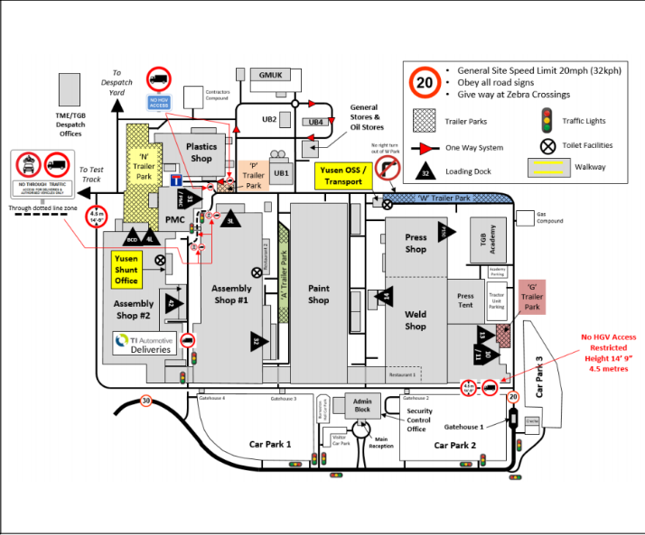
Toyota Sites – Burnaston, UK

Slide 19
Toyota Sites – Burnaston, UK
Driver arrives at gatehouse
Receives map
Barcode on Load Sheet is scanned (driver needs to have paperwork with him)
Parking location is given to the driver
Driver given a scanner and magnetic tag.
Driver goes to Trailer park W – Quality Gate (contains working at height platform and poles, to remove straps)
Opens curtains, removes straps, places straps in POFM roll cage, re-buckles 1 in 5 of curtain buckles
Goes to parking location
Uncouples trailer
Places tag on trailer headboard and scans tag and floor tag
Returns to Yusen (OSS – Onsite Services Office)
Is given pick up location of collecting trailer
Goes to location
Scans trailer tag and location tag.
Removes trailer tag
Couples – up to new trailer
Goes to Quality Door to apply straps
Returns to Gatehouse to leave tag and leave site.

Slide 20
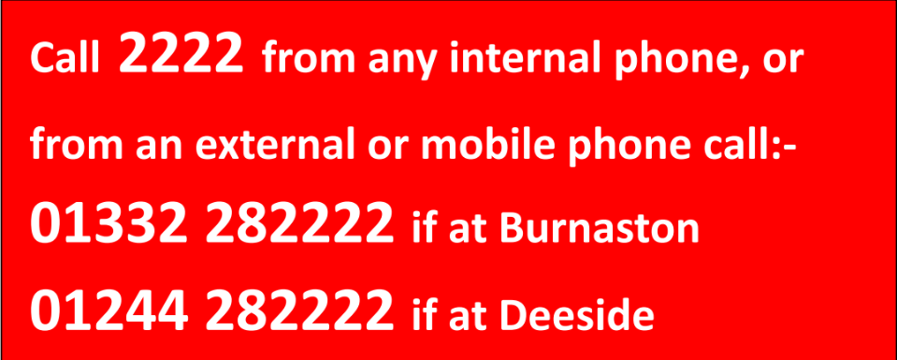
Emergency Numbers

Slide 21







INFORMATION FOR DRIVERS – TOYOTA MOTOR MANUFACTURING (UK) LIMITED
Minimum PPE – You must wear
Safety Shoes
Hi Vis Jacket or Vest
Along with :-
Any Shop specific PPE, please speak to your contact person / Toyota Contract Representative (TCR) BEFORE entering any building.
Never enter production areas unless accompanied by a TMUK member.
FOR YOUR AND OTHERS’ SAFETY : –
Proceed to the area indicated by security or your work instructions.
> If you are unsure, STOP - CALL – WAIT & consult Security or your contact / Toyota Contract Representative (TCR) at TMUK.
Follow your employers’ agreed safe working practices which you have been trained to follow. Remembering, if coupling or uncoupling a trailer :-
> Coupling - confirm trailer brake is on before you start coupling.
> Uncoupling - ensure trailer brake button is applied before leaving.
If delivering to a dock, do not reverse onto the dock until requested to do so. Park in a safe place close to the dock. Follow the Safe Walkways and report to the Dock Team Leader.
When exiting your vehicle, you must switch off the engine
remove the keys and ensure the handbrake is applied.
Always use marked walkways on site. Check before crossing.
Always observe traffic rules - traffic lights, pedestrian crossings.
Smoking on site is prohibited, except in designated areas.
Never use a mobile phone while driving or walking.
IF IN DOUBT STOP CALL WAIT and contact TMUK for guidance
EMERGENCY
In the event of an Emergency call:-
External phone – 01332 28 2222
Internal phone – 2222
Report the location & Incident type.
Report all near misses, accidents and spillages to your Toyota Contract Representative (TCR) / Shop contact or Security on internal number 2115 or
external number 01332 28 2115.
Please note : you are not allowed to remain on site longer than required to complete your delivery and take a short break.
Before you leave this site you must report back to the weighbridge and return this map. Have a safe journey.

Slide 22
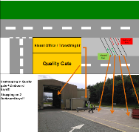
Unstrapping and Strapping at W Park – Quality Door

Slide 23
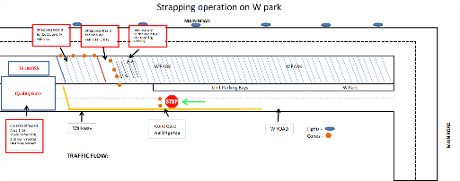
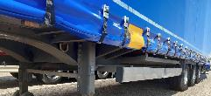
Unstrapping
Inbound:
All inbound vehicles with straps to stop at the Cone Gate
Once either area 1 or 2 is available Traffic controller will give go ahead to move the vehicle
With hazard lights on arrive in designated location and take straps off your load and secure them
When using Area 1 - QG, stop before entering the tent and use signal warning to announce yourself
Where agreed strapping member will be in place to assist with removing straps off the trailer
All inbound vehicles without straps go to inbound bays and report to TF Office
Always use walkway
Place ratchet straps in P&O Ferrymasters strap bin
After unstrapping, replace 1 in 5 buckles on the curtain
1
1

Slide 24
Strapping
Outbound:
All outbound vehicles with drivers willing to strap their load use Area 3 excluding all European routes
Where agreed strapping team will be in place to strap the load on the trailer
QG is accesible only from W Road - one way system
When using Area 1 - QG, stop before entering the tent and use signal warning to announce yourself
All vehicles with straps already on use Outbound bays and report to TF Office
Always use walkway
Use straps from P&O Ferrymasters strap bin

Slide 25
Strapping – Pallets and Stillages
=
Use the facilities at the site (steps / platforms) to apply straps (do not climb)
Strap every row of product
You may require 17 straps
Ready for unloading remove ALL straps from the trailer. Do not leave any straps on the trailer

Slide 26
Toyota Deeside, UK

Slide 27
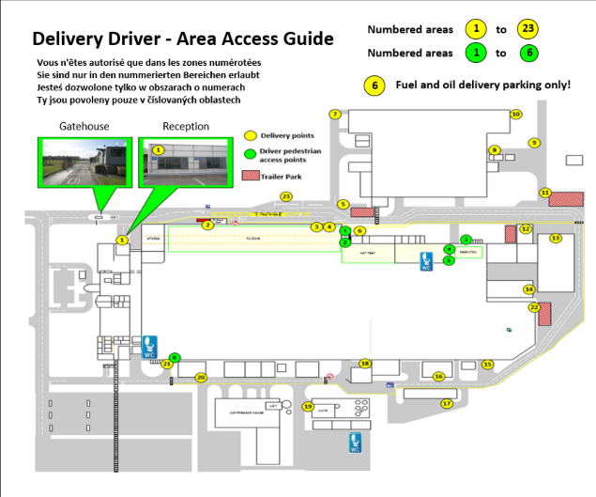

Slide 28
Emergency Numbers

Slide 29
Strapping – Kolox
=
No straps are required

Slide 30
Yusen Logistics (Czech) s.r.o.

Slide 31
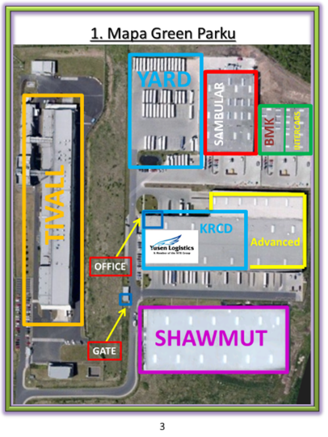
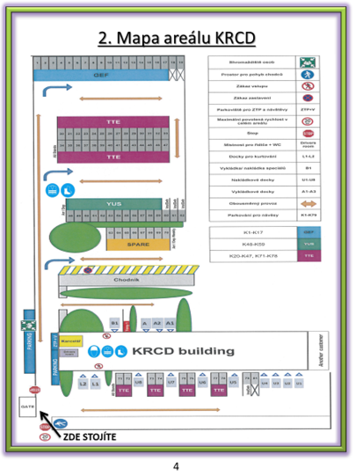

Slide 32
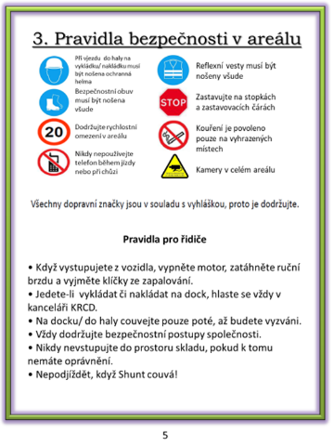
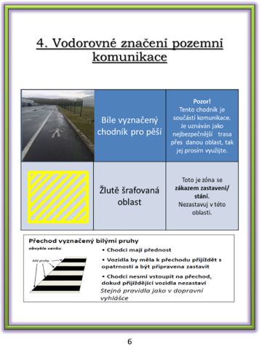
Site Rules

Slide 33
Yusen, Krupka, CZ
Drivers stop before KRCD site gate where pass to staff documents (if has any)
Gate staff give to driver V-Tag which must be placed to trailer on front side
Driver receive position on Yard stand, in case that slot is occupied driver is put on another empty slot and provide information with new parking location share to staff on gate.
When driver leaving KRCD with parts he/she must stop on the gate and receive documents (envelope with CMR and manifests)

Slide 34
Strapping – Pallets and Stillages
=
Use the facilities at the site (steps / platforms) to apply straps (do not climb)
Strap every row of product
You may require 17 straps
Ready for unloading remove ALL straps from the trailer. Do not leave any straps on the trailer

Slide 35
Aisin Manufacturing Europe

Slide 36
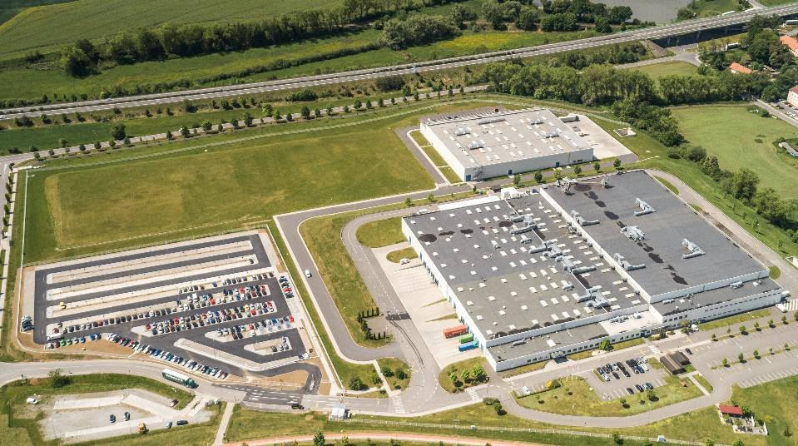

Slide 37
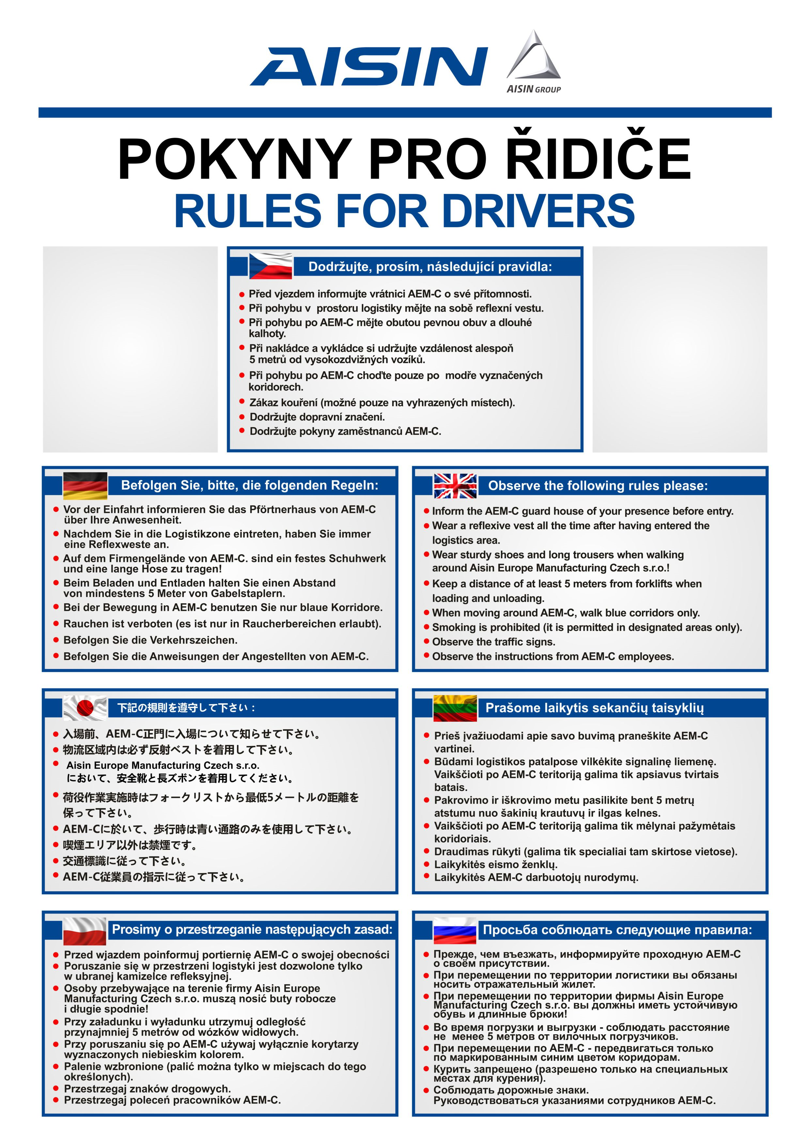
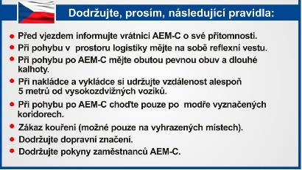
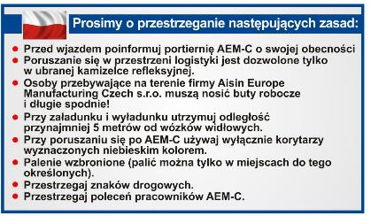

Slide 38
Strapping – Kolox
=
No straps are required

Slide 39
Toyota Motor Manufacturing Poland

Slide 40
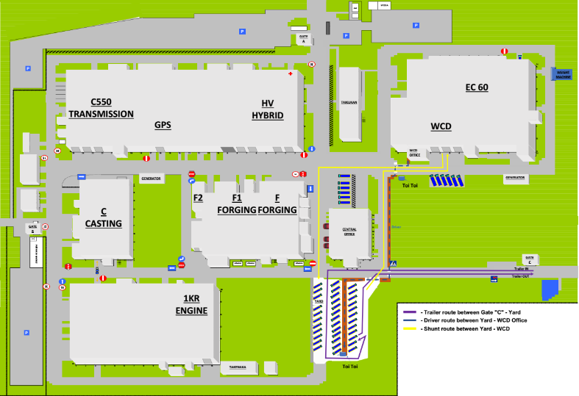

Slide 41
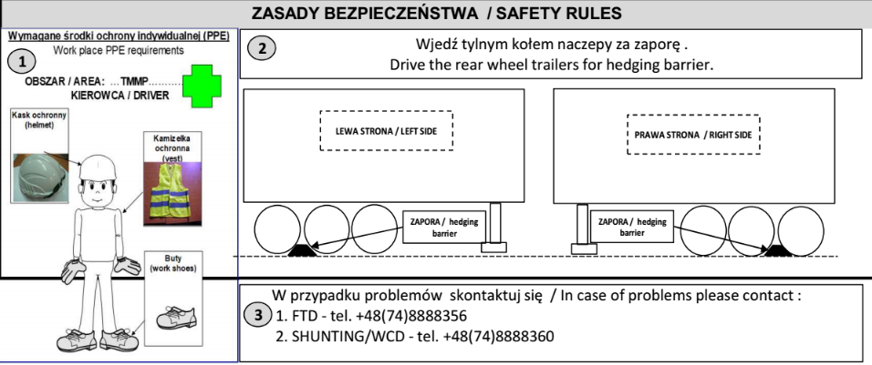

Slide 42
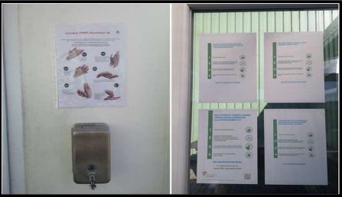
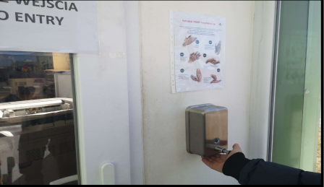
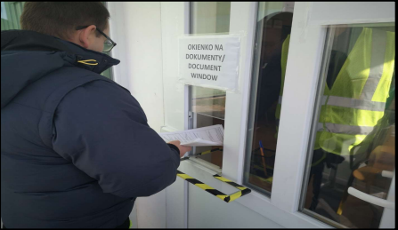
COVID

Slide 43
Strapping – Pallets and Stillages
=
Use the facilities at the site (steps / platforms) to apply straps (do not climb)
Strap every row of product
You may require 17 straps
Ready for unloading remove ALL straps from the trailer. Do not leave any straps on the trailer

