Slide 1
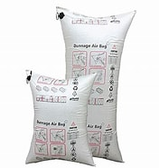
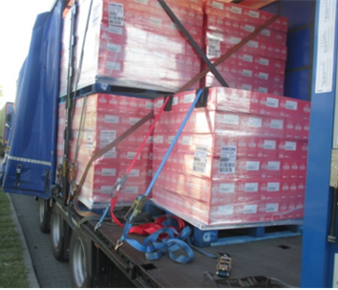
Double Stacked Pallets – Strapping and Cross / Spring Strapping

Slide 2
Double Stacked Pallets – Strapping and Cross / Spring Strapping

Slide 3
Double Stacked Pallets – Strapping and Cross / Spring Strapping

